Slide 1
DevOps Making It Easy to Do the Right Thing
By
Divya Putta,
Nikhila Chinthakindhi,
Saiteja Makani,
Arun

Slide 2
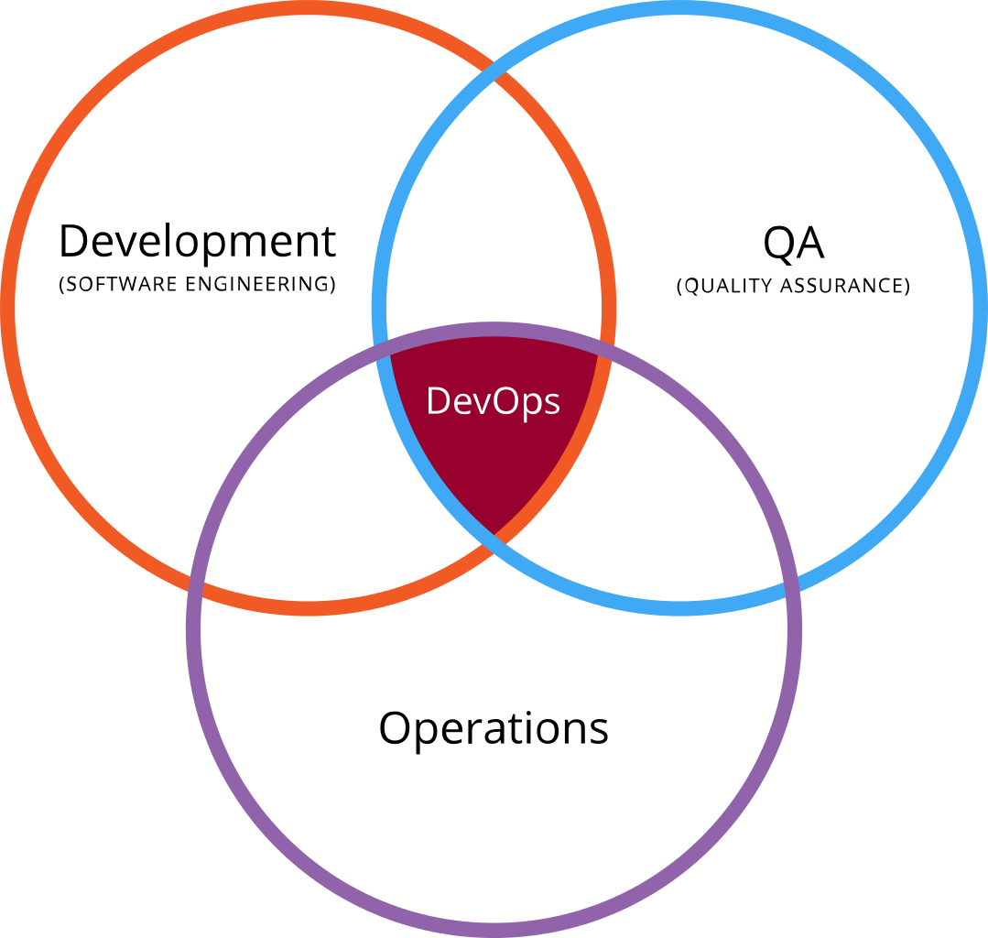
DevOps?
Development
+
Operations
emphasizes the collaboration and communication of both Software Developers and other information-Technology (IT) professionals while automating the process of software delivery and infrastructure changes.

Slide 3
Who Used DevOpps?
Wotif used DevOps principles to recover from the downward spiral of manual release activity. By defining deployment standards for development and operations teams and making them easy to adopt, the company drastically improved the average release cycle time.
Watif??
WOTIF GROUP is one of Australia’s largest travel e-commerce platforms.
In 2013 and 2014,organization overhauled its software release processes,reducing the average releasing time from weeks to hours.

Slide 4
A DevOps and CD transformation enabled this Overhaul.
CD is nothing but Continuous Delivery Transformation.
Wotif faced dilemma on Engineering Departments such as
Infrastructure
Test
Deployment etc.,
To Deal with this,Wotif accept the idea of
“Making It East to Do The Right Thing”

Slide 5


Slide 6
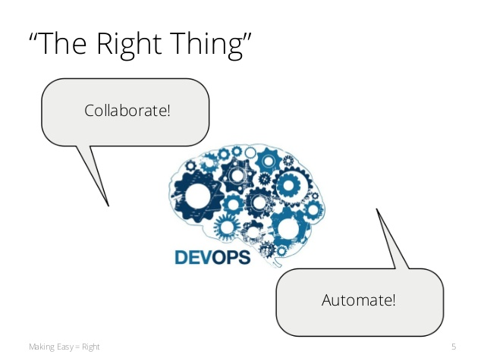
The Right Thing?

Slide 7
Making It Easy??
Automated Verification
The Reference Implementation
Deployment and Test Automation

Slide 8
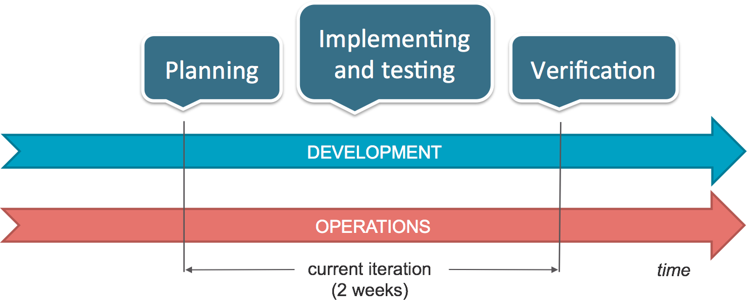
Automated Verification??

Slide 9
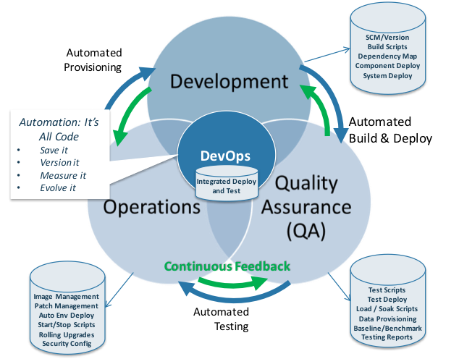
Deployment and Test Automation?

